Slide 1
Algorithm design techniques

Slide 2
Algorithm Design
To now, we have examined a number of data structures and algorithms to manipulate them
We have seen examples of efficient strategies
Divide and conquer
Binary search
Depth-first tree traversals
Merge sort
Quicksort
Greedy algorithms
Prim’s algorithm
Kruskal’s algorithm
Dijkstra’s algorithm

Slide 3
Algorithm Design
We will now examine a number of strategies which may be used in the design of algorithms, including:
Greedy algorithms
Divide-and-conquer algorithms
Dynamic programming
Backtracking algorithms
Stochastic algorithms
There are other techniques not covered in this course:
Evolutionary algorithms
Combinatorial algorithms
Distributed algorithms
Gradient methods

Slide 4
Algorithm Design
When searching for a solution, we may be interested in two types:
Either we are looking for the optimal solution, or,
We are interested in a solution which is good enough, where good enough is defined by a set of parameters

Slide 5
Algorithm Design
For many of the strategies we will examine, there will be certain circumstances where the strategy can be shown to result in an optimal solution
In other cases, the strategy may not be guaranteed to do so well

Slide 6
Algorithm Design
Any problem may usually be solved in multiple ways
The simplest to implement and most difficult to run is brute force
We consider all possible solutions, and find that solution which is optimal

Slide 7
Algorithm Design
Brute force techniques often take too much time to run
We may use brute-force techniques to show that solutions found through other algorithms are either optimal or close-to-optimal

Slide 8
Algorithm Design
With brute force, we consider all possible solutions
Most other techniques build solutions, thus, we require the following definitions
Definition:
A partial solution is a solution to a problem which could possibly be extended
A feasible solution is a solution which satisfies any given requirements

Slide 9
Algorithm Design
Thus, we would say that a brute-force search tests all feasible solutions
Most techniques will build feasible solutions from partial solutions and thereby test only a subset of all possible feasible solutions

Slide 10
Algorithm Design
It may be possible in some cases to have partial solutions which are acceptable (that is, feasible) solutions to the problem
In other cases, partial solutions may be unacceptable, and therefore we must continue until we reach a feasible solution

Slide 11
Algorithm Design
We will look at two problems:
the first requires an exact (optimal) solution,
the second requires only an approximately optimal solution
In the second case, it would be desirable, but not necessary, to find the optimal solution

Slide 12
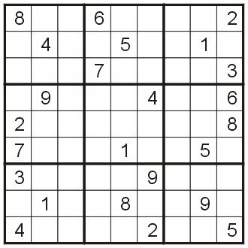
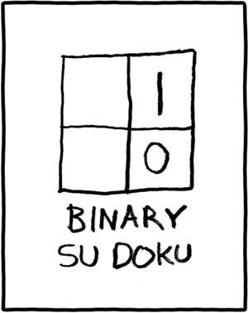
Example 1
For example, consider the game of Sudoku
The rules are:
each number must appear once in each row, column, and 3 × 3 outlined square
You are given some initial numbers, and if they are chosen appropriately, there is a unique solution
http://xkcd.com/74/

Slide 13
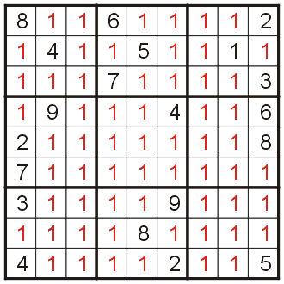
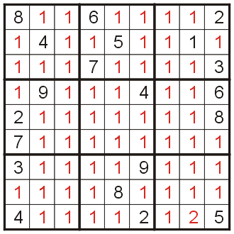
Example 1
Using brute force, we could try every possible solution, and discard those which do not satisfy the conditions
This technique would require us to check 9⁶¹ ≈ 1.6×10⁵⁸ possible solutions

Slide 14
Example 2
Suppose you are a manager, and you have 26 weeks or half a year for the next product cycle
You have n possible projects, however, the time required to complete these projects is much greater than 26 weeks
Associated with each possible project are numerous factors:
The expected completion time
The expected increase in revenue
A probability of failure
Possible future projects which may benefit

Slide 15
Example 2
Stake holders include:
Team members
Marketing
Other management
The executive team
You must now decide which projects must be chosen so as to satisfy the schedule
It must be justifiable

Slide 16
Example 2
In this case, it is almost impossible to come up with a optimal choice of projects, however, you are required to come up with an appropriate solution
We will see how an appropriate choice of algorithm may lead us towards a reasonably optimal solution

Slide 17
Example 2
In this case, any sub-set of the n projects forms a partial solution
A partial solution is a feasible solution if the sum of the expected completion times is less than six months

Slide 18
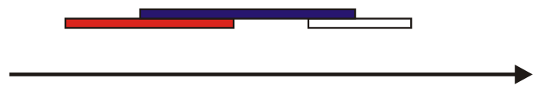
Example 3
Another case we will look at is interval scheduling:
Given n processes, all of which must be run at specific times, maximize the number of processes that are run
This has a reasonably simple solution that we will see next topic

Slide 19
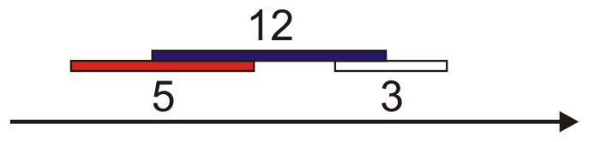
Example 3
However, if you modify the problem:
Given n processes, all of which must be run at specific times and where each is given a specific weight, maximize the total weight of the processes that are run
This has a more complex solution that we will see in the next week

Slide 20
Algorithm Design
Thus, over the next few lectures, we will look at a number of algorithm design techniques which may, in some circumstances provide either optimal or near-optimal solutions

Slide 21
References
Wikipedia, http://en.wikipedia.org/wiki/Algorithm_design
These slides are provided for the ECE 250 Algorithms and Data Structures course. The material in it reflects Douglas W. Harder’s best judgment in light of the information available to him at the time of preparation. Any reliance on these course slides by any party for any other purpose are the responsibility of such parties. Douglas W. Harder accepts no responsibility for damages, if any, suffered by any party as a result of decisions made or actions based on these course slides for any other purpose than that for which it was intended.

